Slide 1
Module 1: An Overview of United Nations Peacekeeping Operations
Lesson
1. 7
Working as One in the Mission

Slide 2
Relevance
As peacekeeping personnel you must know:
Your work
Work of other components in the mission
How all work connects
Important contribution to common goal
UN Core Pre-Deployment Training Materials 2017

Slide 3
Learning Outcomes
Learners will:
Explain importance of working together to achieve the mandate
Explain differences in “institutional culture” between military, police and civilians
Explain main role of military, police and civilians
UN Core Pre-Deployment Training Materials 2017

Slide 4
Lesson Overview
Importance of Different Mission Components Working Together
Cooperating Across Differences in Institutional Culture
The Military Component
The Police Component
The Civilian Component
UN Core Pre-Deployment Training Materials 2017

Slide 5
Learning Activity
1.7.1
Differences in the Mission
Instructions:
Consider the DPKO factsheet on UN peacekeeping operations
List the differences
Discuss the advantages and challenges
Time: 10 minutes
Group work: 5-7 minutes
Discussion: 3 minutes
UN Core Pre-Deployment Training Materials 2017

Slide 6
1. Importance of Different Mission Components Working Together
Work of each component affects tasks of others
All contribute to achieving mandate
Complex mandates, difficult environments – must help each other
Military
Civilian
Police
UN Core Pre-Deployment Training Materials 2017

Slide 7
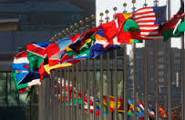
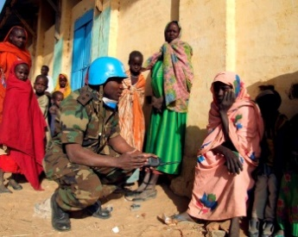
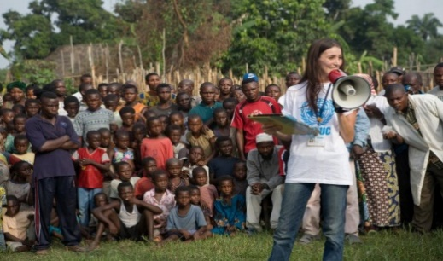
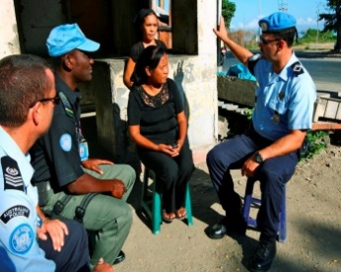
2. Cooperating Across Differences in Institutional Culture
Military: system of hierarchy, clear lines of authority
Police: similar lines of authority to military
Civilians: flexible management models
Civilians versus Military/Police: ambiguity versus strong planning culture
UN Core Pre-Deployment Training Materials 2017

Slide 8
2. Cooperating Across Differences in Institutional Culture
Respect for diversity
Be open to cooperation
Learn about others’ work
Share work
UN Core Pre-Deployment Training Materials 2017

Slide 9
Learning Activity
1.7.2
The Peacekeeping Body
Instructions:
Consider the different parts of the human body
How does each part contribute to the functioning of the whole body?
Compare with the mission
Time: 5 minutes
Brainstorming: 3 minutes
Discussion: 2 minutes
UN Core Pre-Deployment Training Materials 2017

Slide 10
3. The Military Component
The Role
Primary function:
Provide a secure environment as a precondition for moving ahead on other elements of the peace process
Military
UN Core Pre-Deployment Training Materials 2017

Slide 11
Three Main Categories
Formed Military Units or Contingents
Military Experts on Mission
Staff Officers
UN Core Pre-Deployment Training Materials 2017

Slide 12
4. The Police Component
The Role
Two core functions:
Operational support/interim
executive policing and other
law enforcement
Support for reform, restructuring
and rebuilding of host state police
Police
UN Core Pre-Deployment Training Materials 2017
Notes:
Suggest to remove Police circle. Makes the slide look too busy with no added value

Slide 13
Three Main Categories
Individual Police Officers
Formed Police Units
Specialized Police Teams
UN Core Pre-Deployment Training Materials 2017

Slide 14
Diversity of Policing Cultures
Different legal systems, structures, approaches to policing
Leads to misunderstanding of local legal systems in host country
Need basic understanding of local laws
UN Core Pre-Deployment Training Materials 2017

Slide 15
5. The Civilian Component
The Role
Provides technical expertise for both substantive and support work
Wide variety within civilian component
Civilian
UN Core Pre-Deployment Training Materials 2017
Notes:
Suggest to remove Civilian circle.

Slide 16
Two Different Types
Civilian Substantive Component
Civilian Support Component
UN Core Pre-Deployment Training Materials 2017

Slide 17
Learning Activity
1.7.3
Balloon Debate
Instructions:
You are either military, police or a civilian
The hot air balloon to the mission is too heavy and about to crash
Give reasons why you should stay onboard
Time: 10 minutes
Group work: 5-7 minutes
Discussion: 3 minutes
UN Core Pre-Deployment Training Materials 2017

Slide 18
Summary of Key Messages
Work together to achieve mandate
Respect diverse “institutional cultures” of military, police and civilians
UN military, police and civilians all play unique and important roles
UN Core Pre-Deployment Training Materials 2017

Slide 19
Questions
UN Core Pre-Deployment Training Materials 2017

Slide 20
Learning Activity
Learning Evaluation
UN Core Pre-Deployment Training Materials 2017

